Slide 1

Exploring Community Flood Resilience in Bang Rakam, Thailand
Smart Villages Webinar
Going off the grid: Disaster, resilience, and off-grid energy
November 22, 2016
Shorna B. Allred
Associate Professor and Associate Director
Human Dimensions Research Unit
Dept. of Natural Resources

Slide 2


Acknowledgements
Associate Professor Dr. Kampanad Bhaktikul
Assistant Professor Dr.Patana Thavipoke
Assistant Professor Dr.Piyakarn Teartisup
Assistant Professor Dr. Sanpisa Sritrairat
Assistant Lecturer Dr. Pattrawut Pusingha
Mr. Choompol Pitchayachai, Chief of Disaster Prevention and Mitigation, Disaster Prevention and Mitigation Provincial‬ Office, Nakhon Pathom
  Bang Rakam Subdistrict Administrative Organization (SAO), Banglen District, Nakorn Pathom, Community members and government officials in Moo 2, Moo 3, Moo 4, Moo 6, Moo 7, Moo 8, Moo 9
  Global Citizenship and Sustainability Program Students (2014-15):
  Alexa Bakker, Treijon Johnson, Cadell Williams, Logan Lin, Ariel Smilowitz, Gabrielle Hickmon, Roda Zigetta, Mariela Graciela, Matt Clauson

Slide 3
Community Resilience
Community resilience is the capacity of a distinct community or cultural system to absorb disturbance and reorganize while undergoing change so as to retain key elements of structure and identity that preserve its distinctness (Healy 2006).

Slide 4
Participatory Knowledge Management for Resilience
Different types of knowledge required for resilience (Hordijk and Baud 2010)
Important to understand the processes by which knowledge is produced, recognized and prioritized (Hordijk and Baud 2010)
Resilience emerges from a set of networked adaptive capacities
Information and communication are thus important domains of resilience

Slide 5
Community Resilience Model
Institutional Memory
Innovative Learning
Connectedness
Assets
Community Resilience
Adaptive Capacities
Resource Robustness
Community Competence
Social
Capital
Economic Development
Resource Quality
Resource Redundancy
Resource Diversity
Resource Assets
Diversity of economic resources
Equity of resources distribution
Attachment to place
Sense of community
Formal ties
Informal ties
Perceived social support
Actual social support
Organizational linkages and cooperation
Community action
Problem-solving and reflection
Flexibility and creativity
Collective efficacy
Empowerment
Political partnerships
Adapted from Longstaff et al. 2010 and Norris et al. 2008

Slide 6
Research Questions
How is flood knowledge transferred in the community?
What aspects of the community contribute to resilience?
How has flood knowledge changed over time?

Slide 7
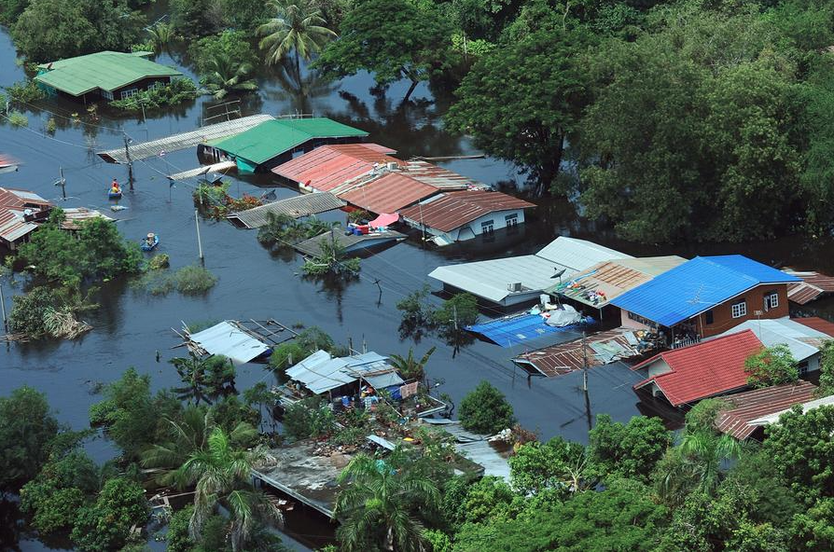
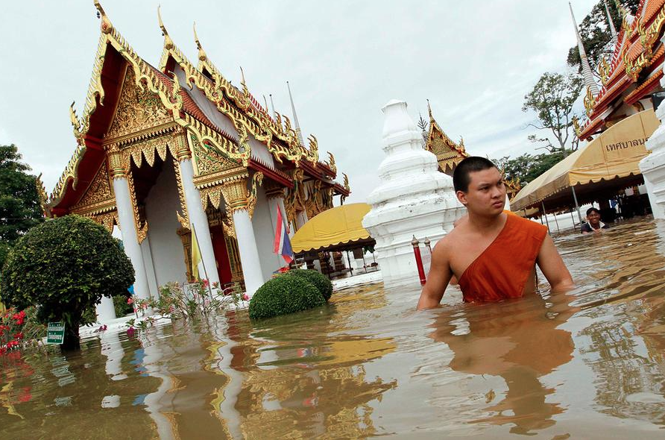
2011 Floods
(Reference 6)

Slide 8
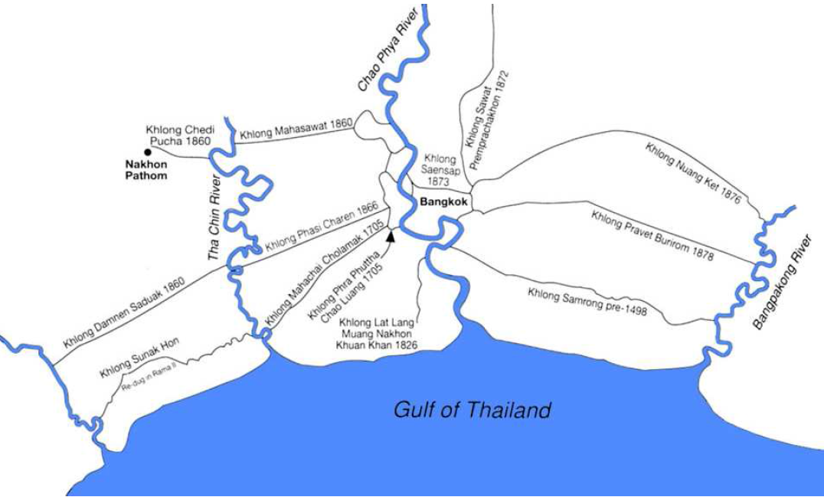
Bangkok’s Water System
Figure Lower basin canals.
Source: Beek, Steve Van. The Chao Phya River in Transition. Singapore: Oxford, 1995 (122)

Slide 9
Research Methods
Narrative interviews with villagers (n=29) and sub-district officers (n=7) in Bang Rakam
Conducted interviews in person at their home, farm, village, or office
Audio recording, field notes, translation
Thematic coding

Slide 10
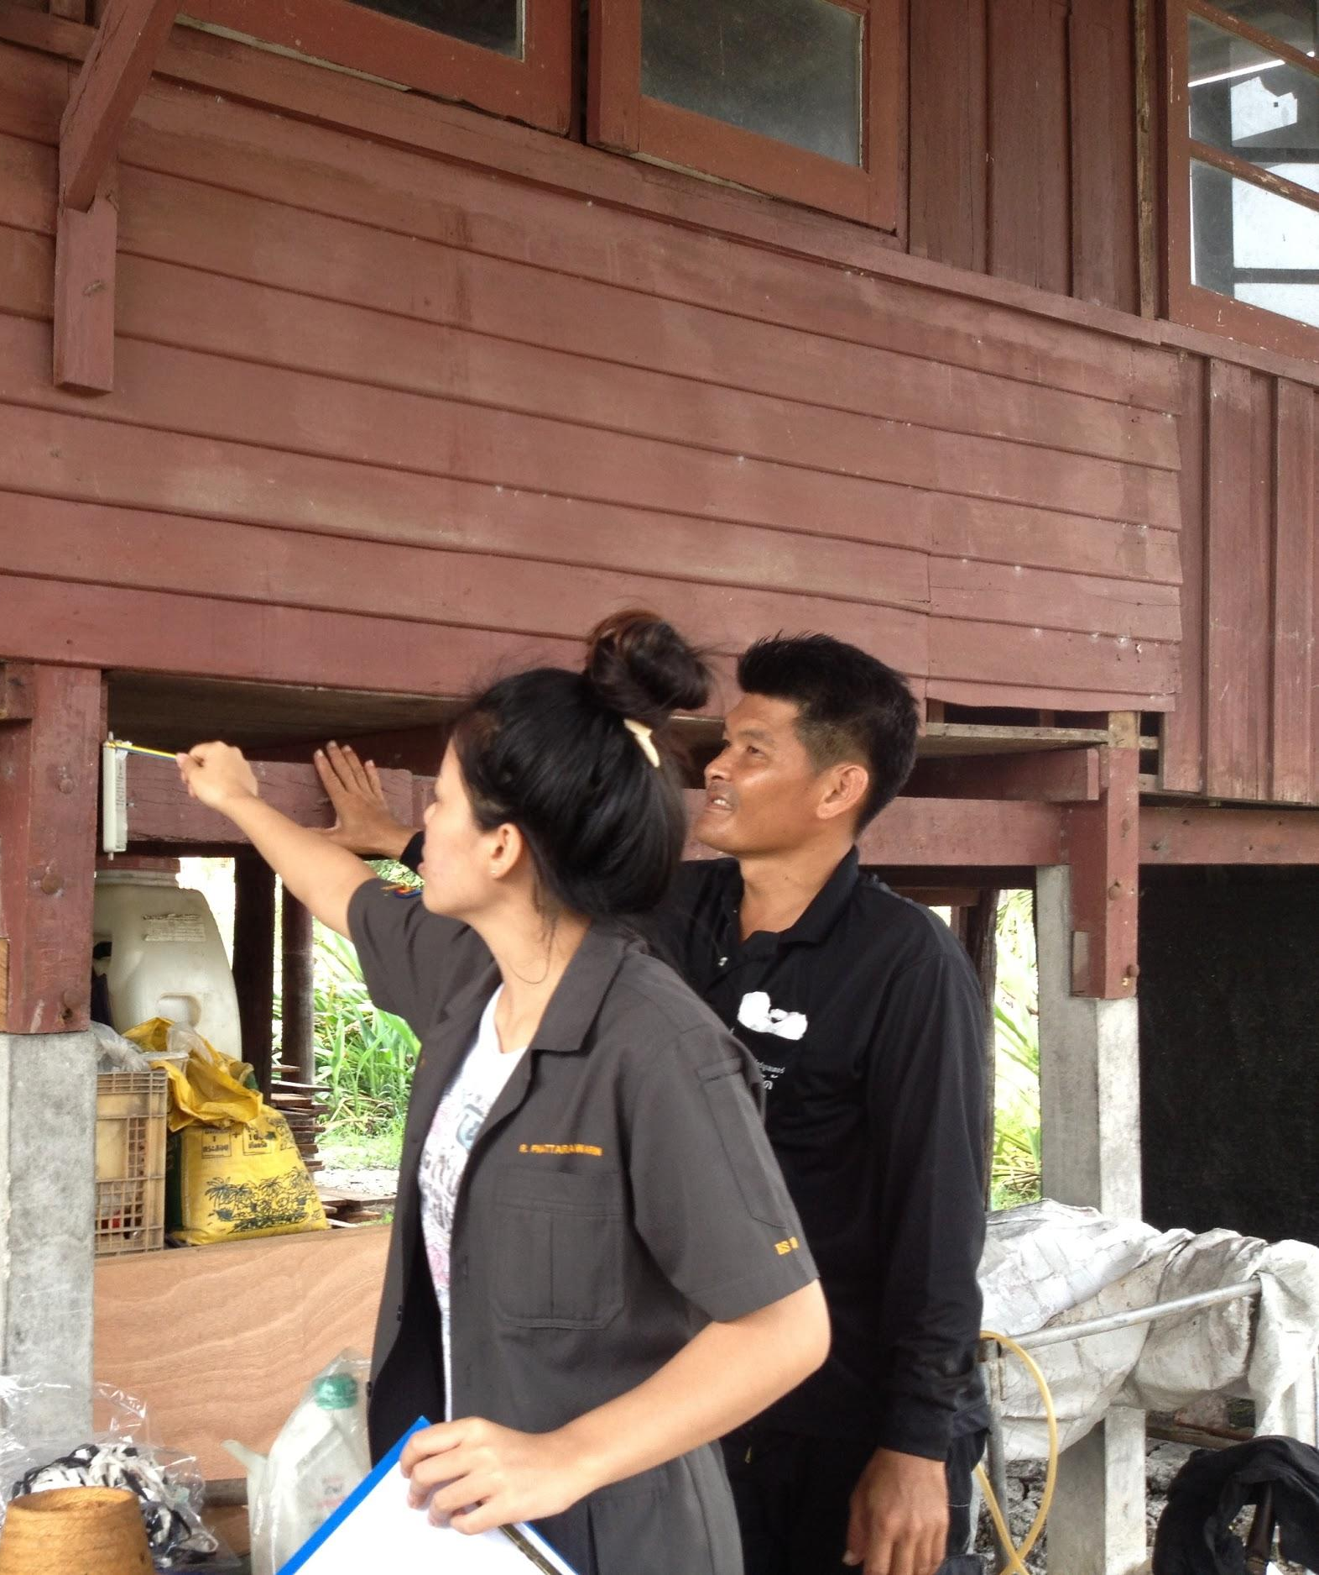
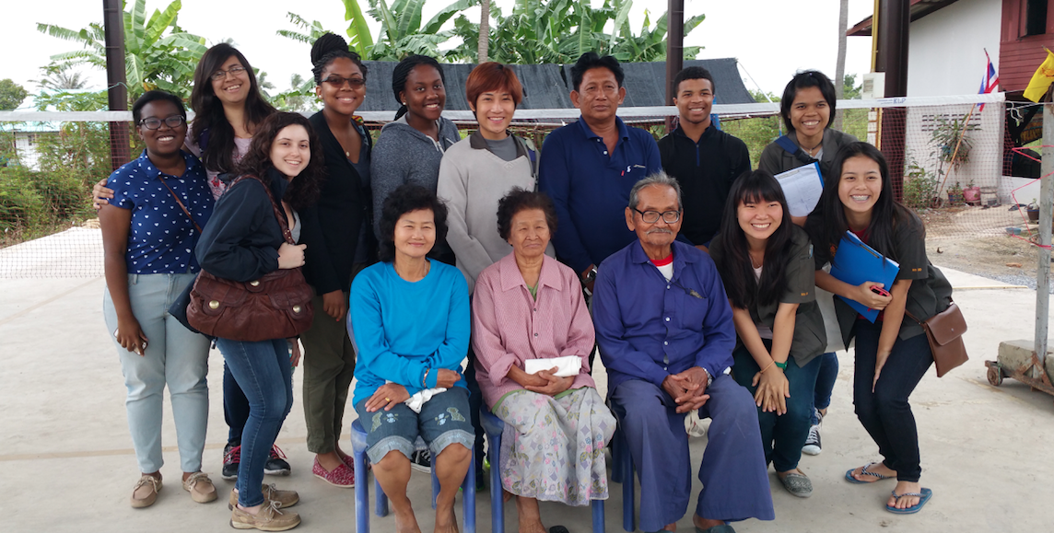
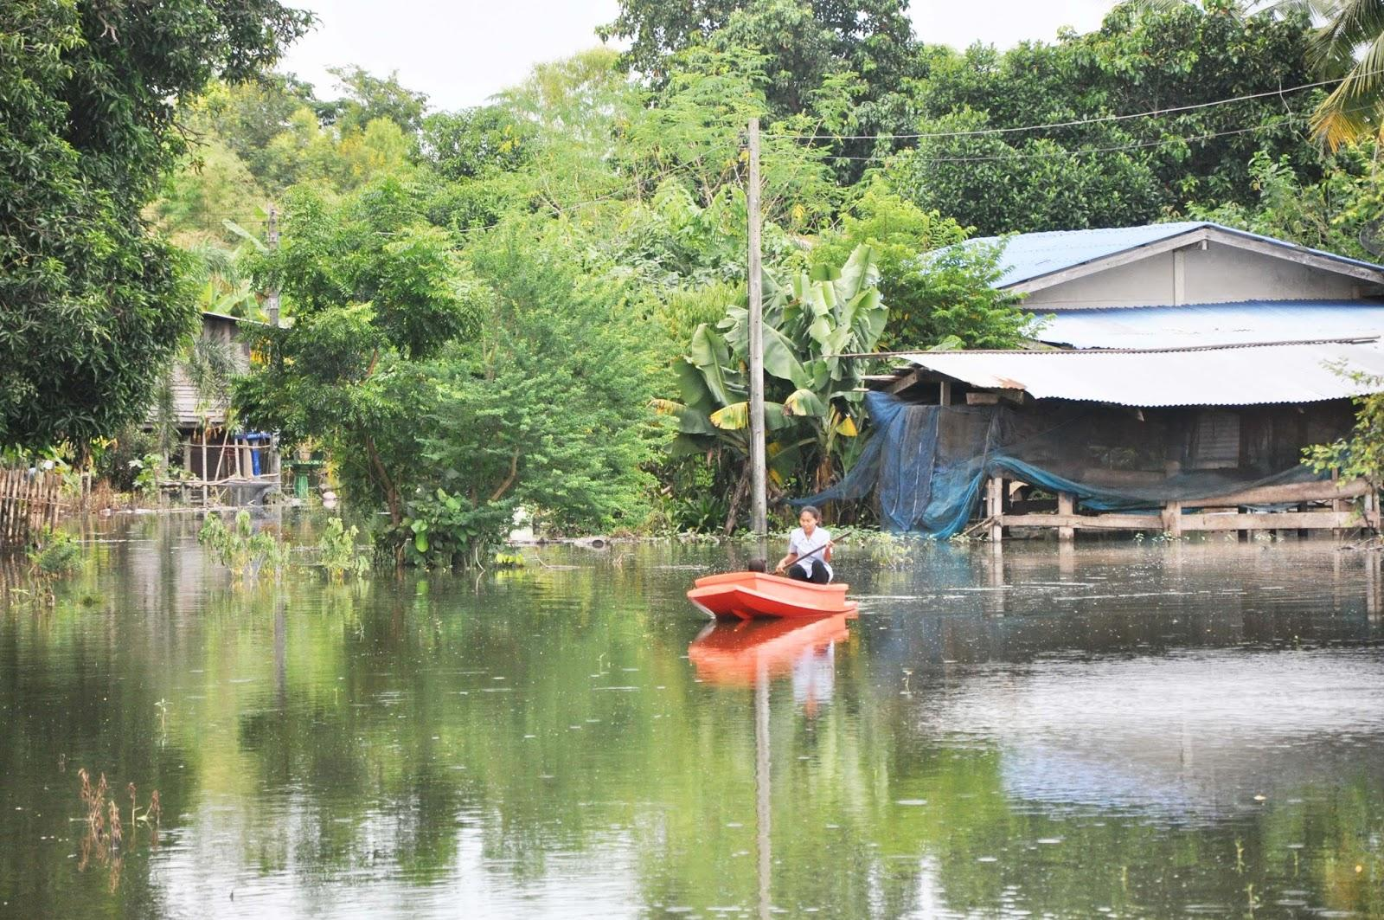
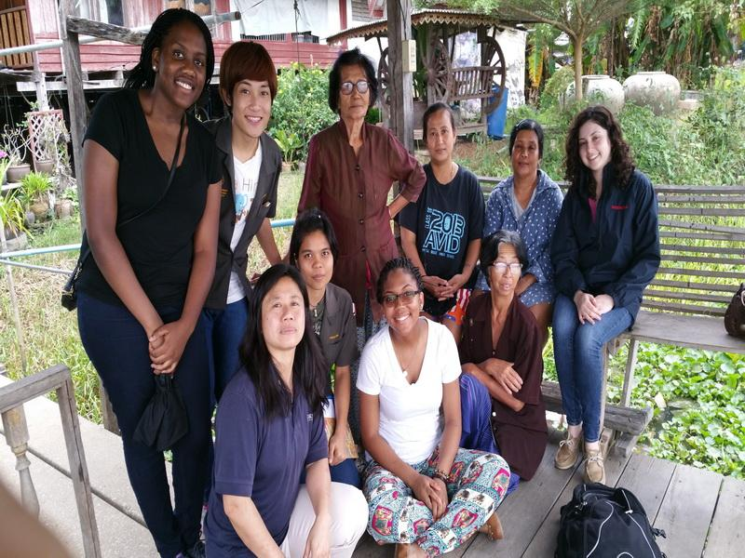
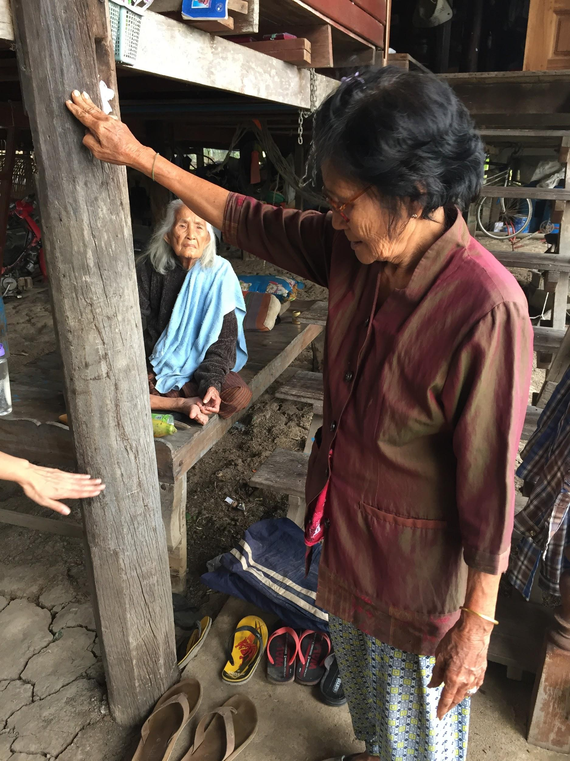
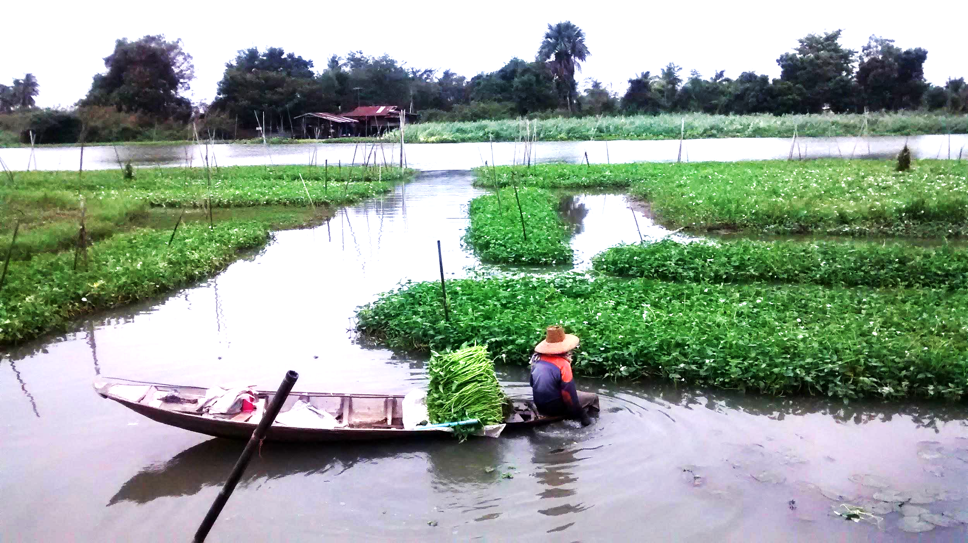
Community Flood Narratives

Slide 11
Adapting to Floods as Way of Life
“Flood impacts everyone and everything. We have lived during the floods for our entire lives. We have accepted the fact that adapting to the floods are a part of their way of life.”
“We can adapt because we face the floods every year”
เราสามารถปรับตัวได้เพราะเราเจอน้ำท่วมทุกปี

Slide 12
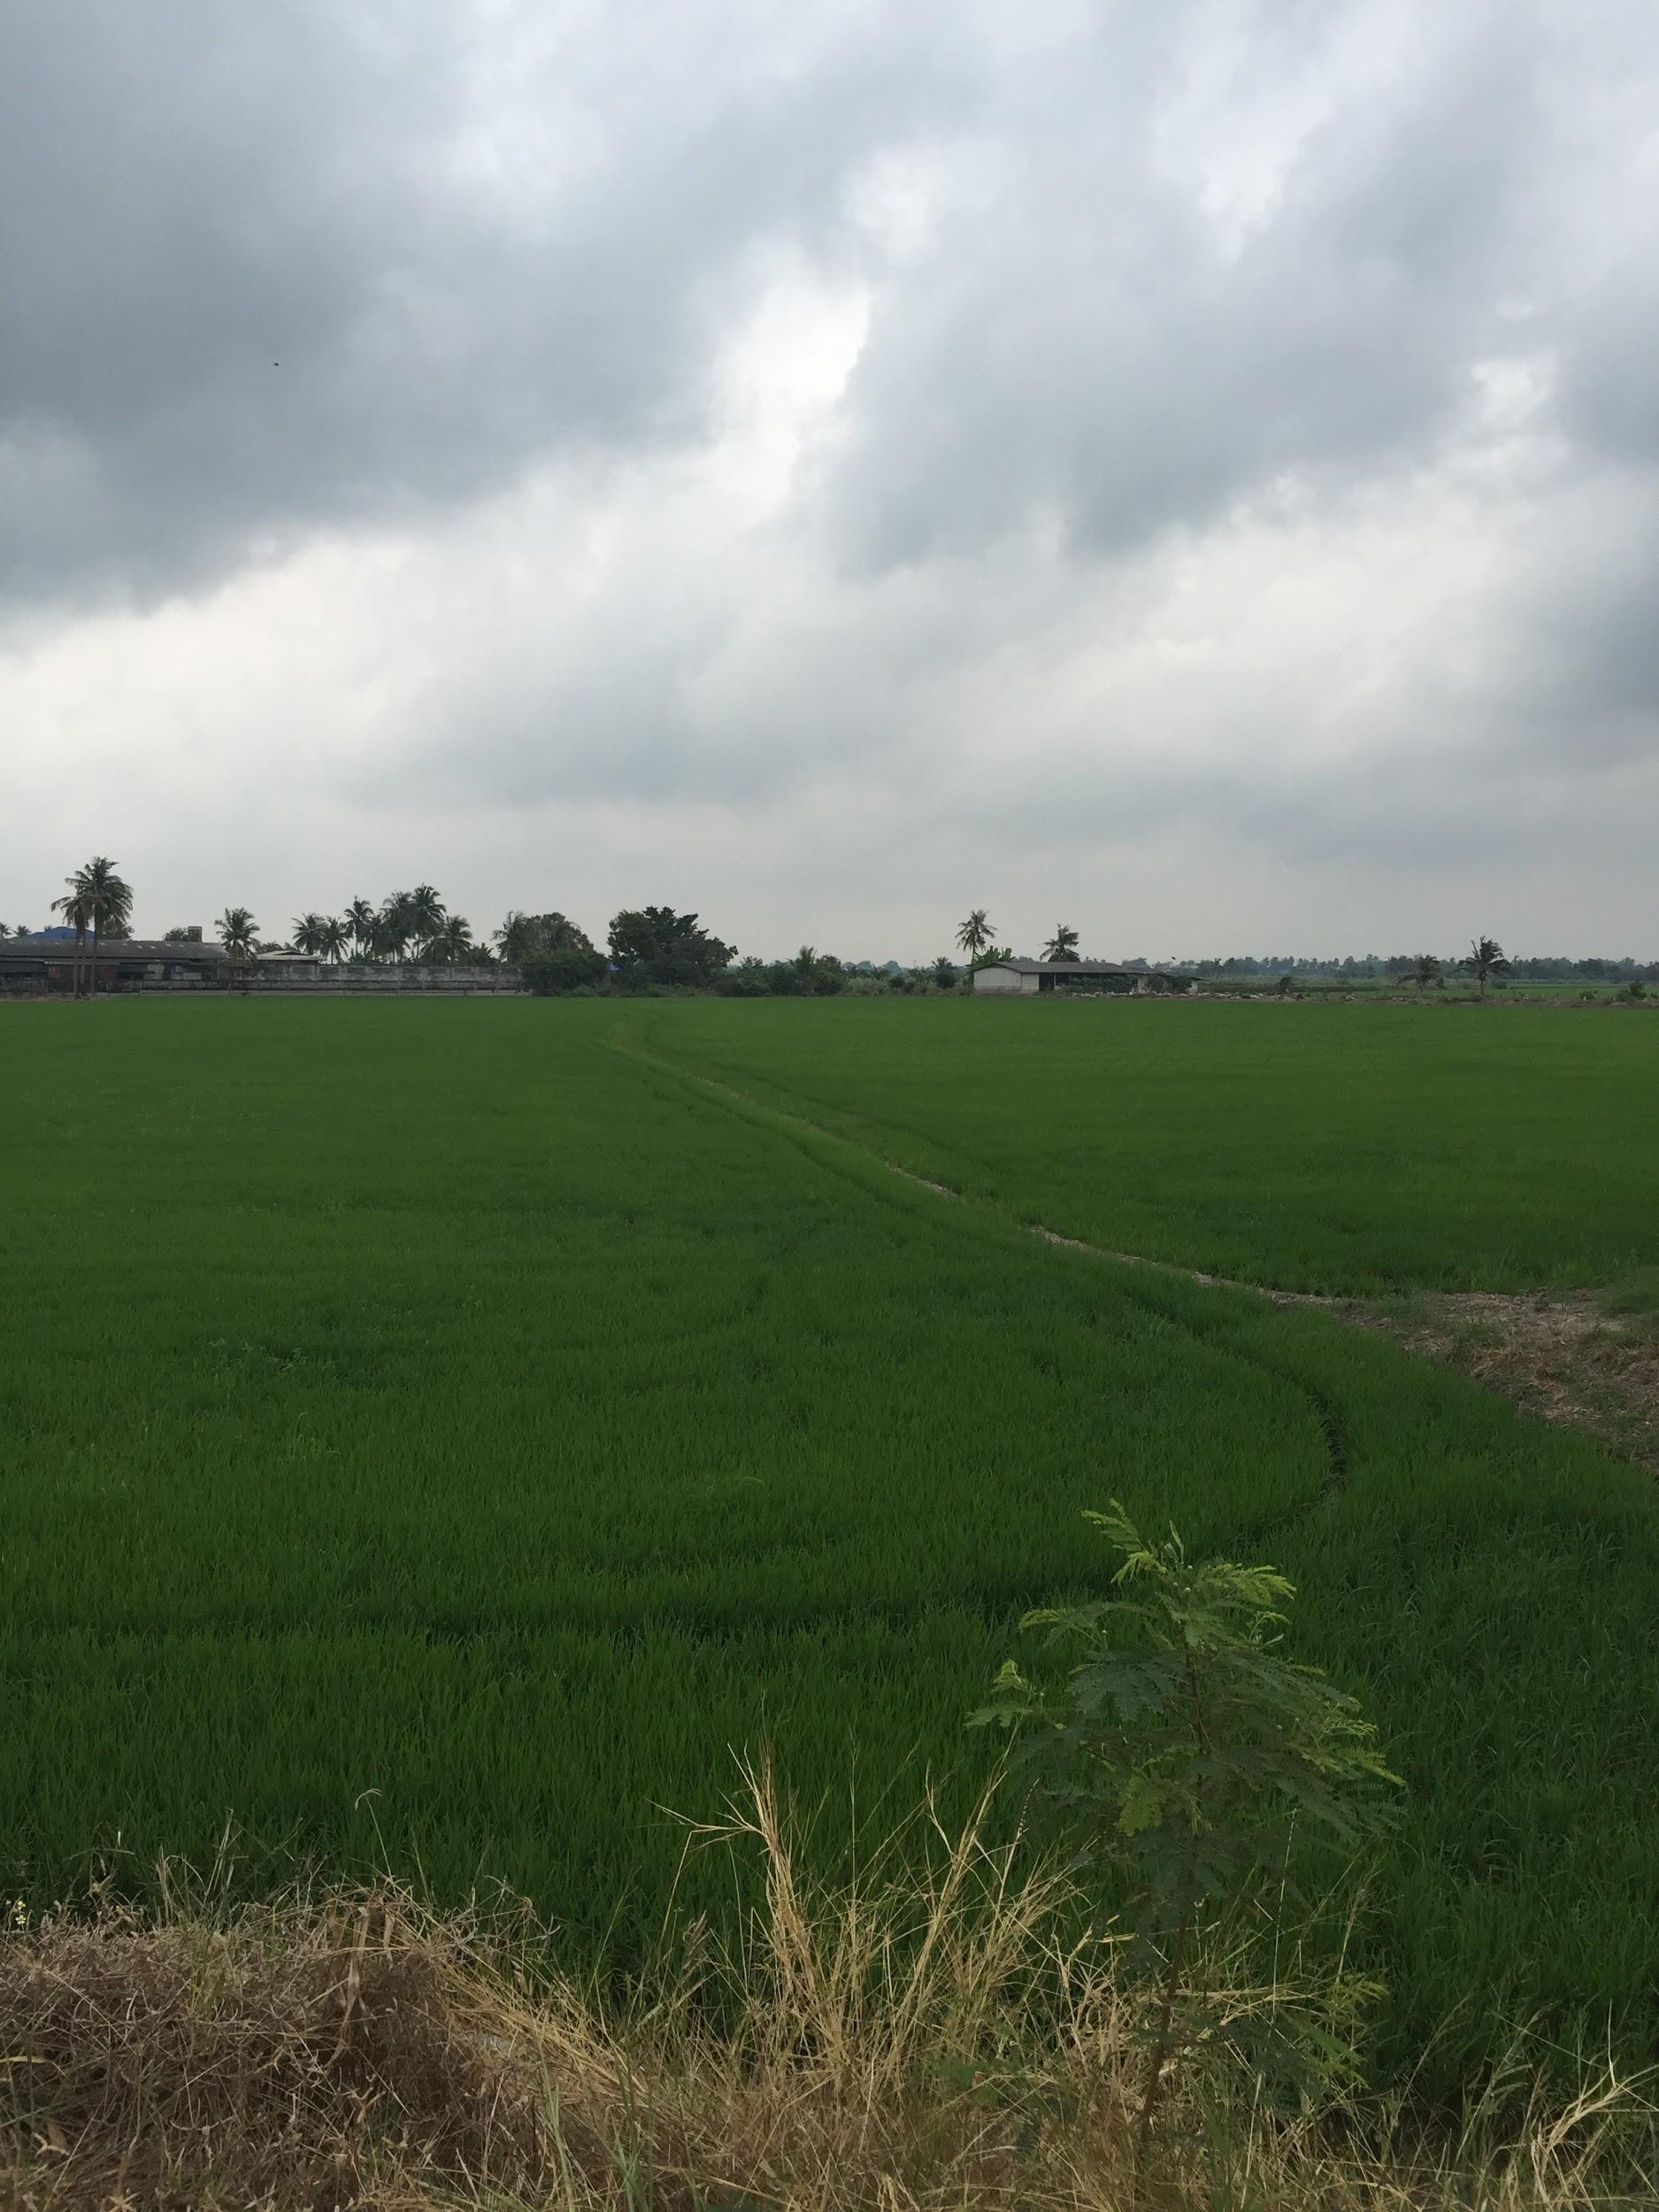
Flood Knowledge
All interviewees knew flooding was coming based on past experience and natural indicators
More reliance on SAO to notify village leaders of when exactly the flood would come
Some used TV and radio to access information

Slide 13
Adaptations
Housing and Transport
2 Story House
Stilts
Raising floor when there are high levels of water
Transportation (Boats)

Slide 14
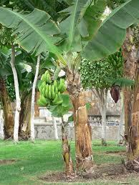
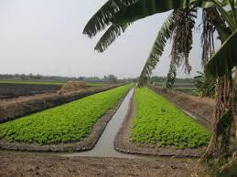
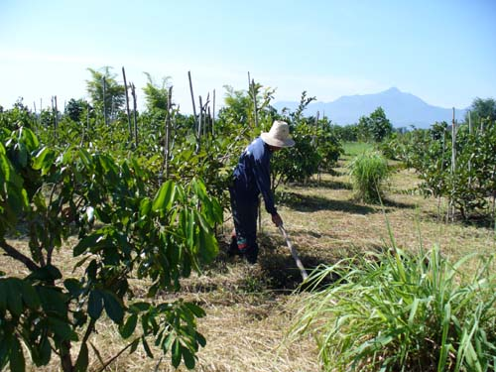
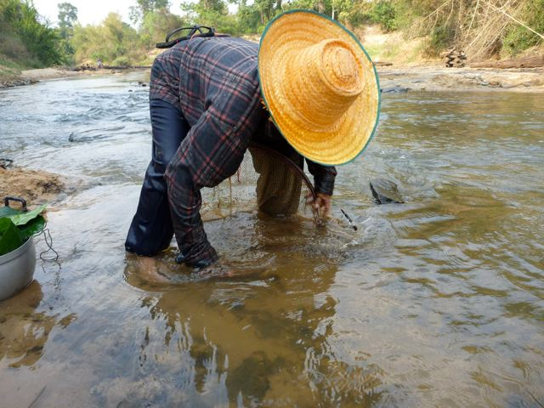
What are the differences in flood management from when you were young to now?
Moo 6
Crop Change
Short-term Plants
Banana Trees
Moo 2,6,9
During Floods

Slide 15
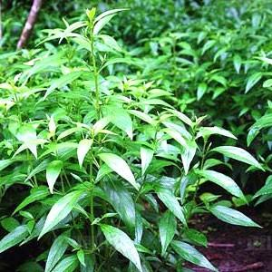
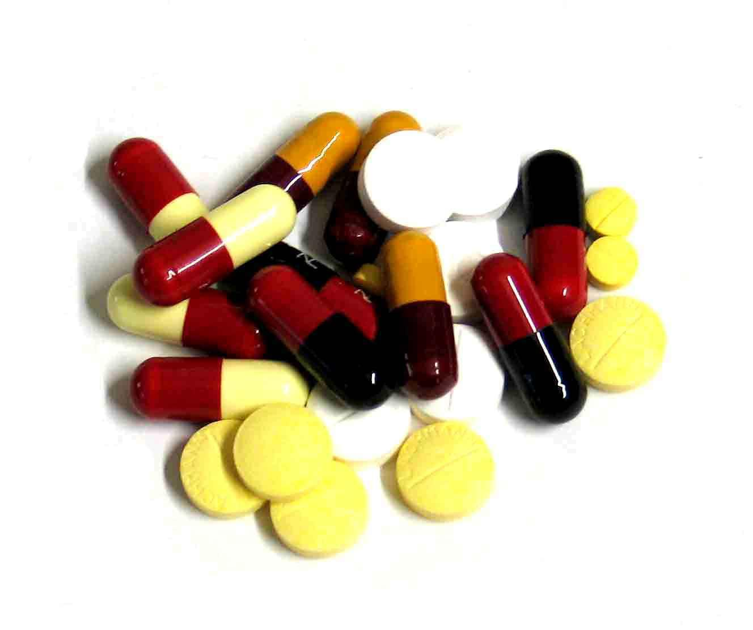
Adaptations
Past:
Use of Thai Herbs
Now:
Reliance on Doctors and Modern Medicine
Moo 9

Slide 16
Flood Knowledge
All emphasized observation as the main way of learning.
A few, but not many, were passing on flood knowledge to their children.
SAO chief expressed concern about children moving out of the villages for work and losing their local wisdom and attachment to nature, but not all interviewees shared this concern
One interviewee taught her children about farming solely so that they would see how difficult it was and choose to pursue a less labor-intensive job
Most thought the schools should teach about flooding preparation

Slide 17
Strength of Community
“I would like for the community to find a way to help themselves and each other more before coming to the government to ask for help. I believe that this will increase the strength of the community and increase our knowledge about protecting [ourselves] in the flood, instead of relying on the government for support.”

Slide 18
Decrease in helping each other
“The biggest difference I noticed from traditional techniques is the fact that people used to put more effort into helping each other. When people needed to move or evacuate their belongings, community members were there for support. There was once more interdependence. Due to relying more on the government, people have started helping each other less. This has lead people to only help themselves when they can, moving their own belongings and evacuating themselves.”

Slide 19
Sharing
“…families share the food that we grow for others in the community. For example, families that grow morning glory and those that catch fish might share with each other to make a more complete meal.”

Slide 20
Conclusions
Knowledge about flooding is transferred primarily through observation
Villagers would like to be informed earlier about the volume and velocity of the water
Community members often needed to change the crops they planted to adapt to longer flooding periods.
Community solidarity during the flood and reliance on other village members but not all shared this view.
Some believe reliance on government and SAO has contributed to a decrease in the local flood knowledge.

Slide 21

Thank you
Shorna Allred
srb237@cornell.edu

