Slide 1
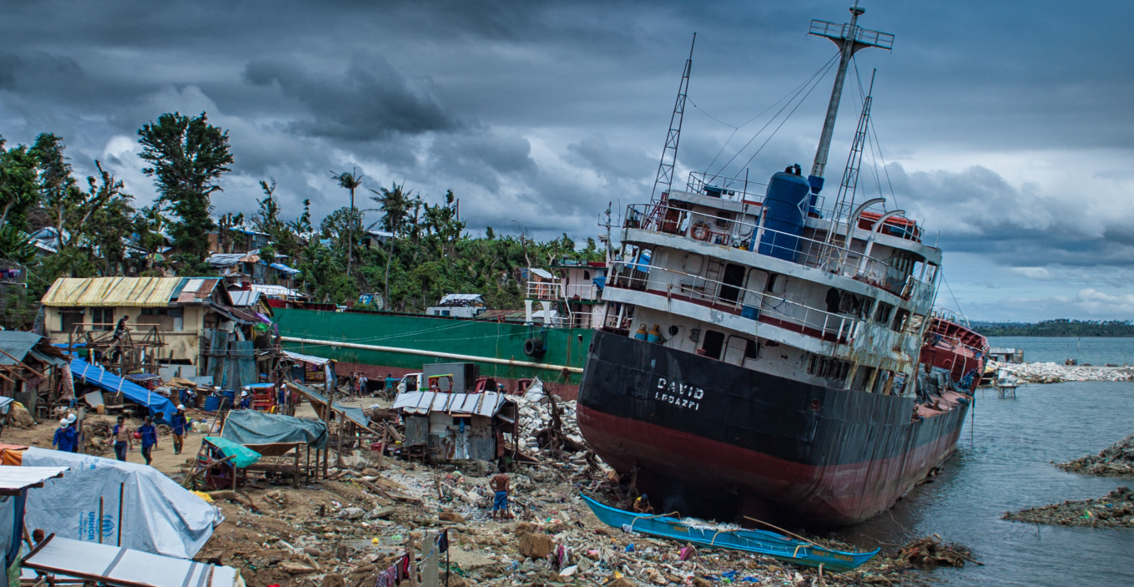
smart villages & REsILIENCE
Nov 2016
Bernie Jones

Slide 2
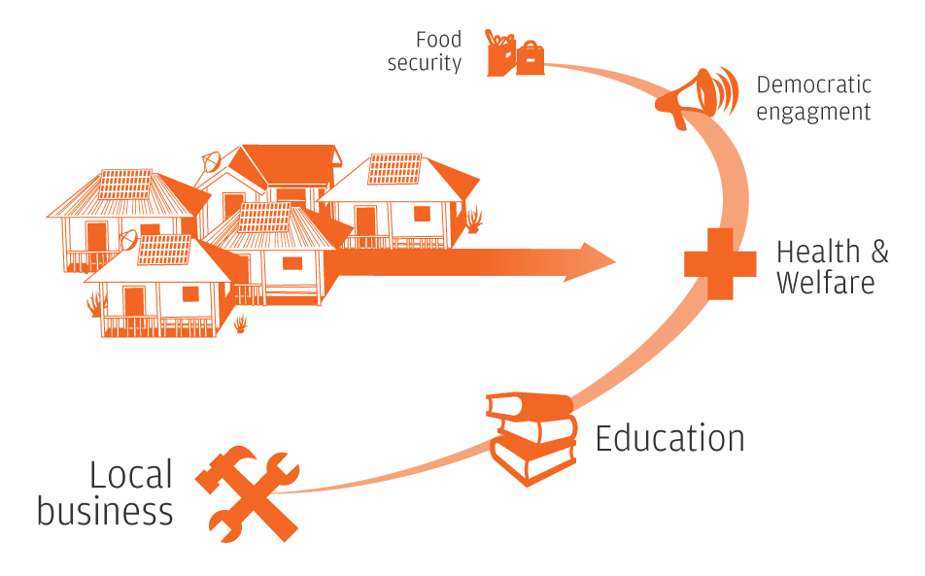
SMART village
Decentralised infrastructure
ICT & networking
Innovative remote service provision
Community engagement
Economic & social development

Slide 3

shocks
Natural disasters
Economic
Conflict
Health
Infrastructure failure

Slide 4
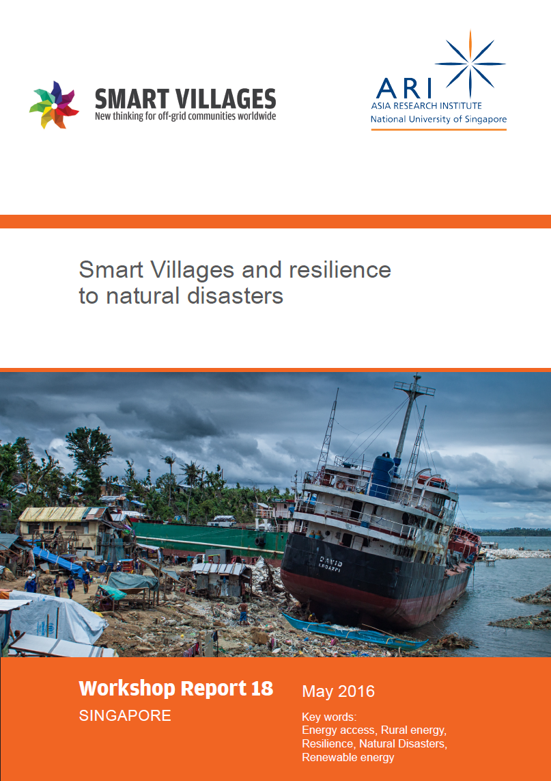
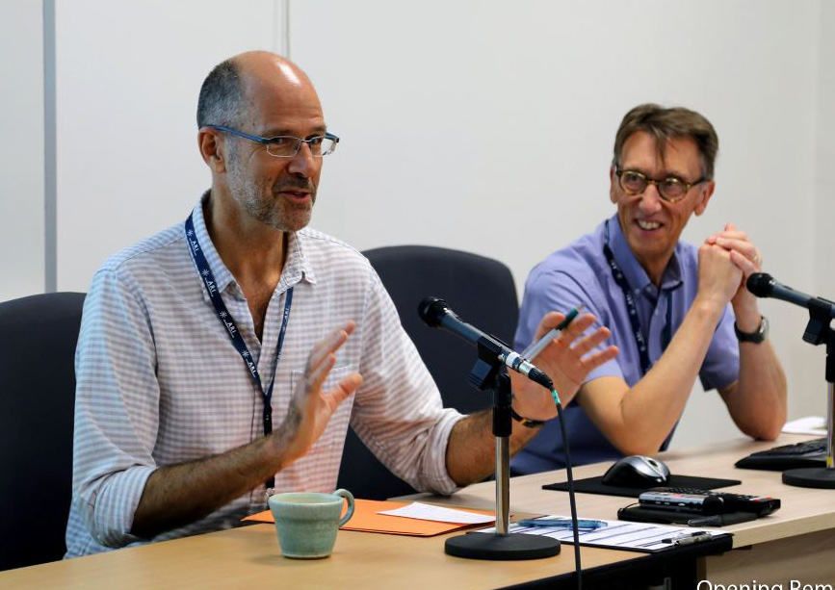

Slide 5
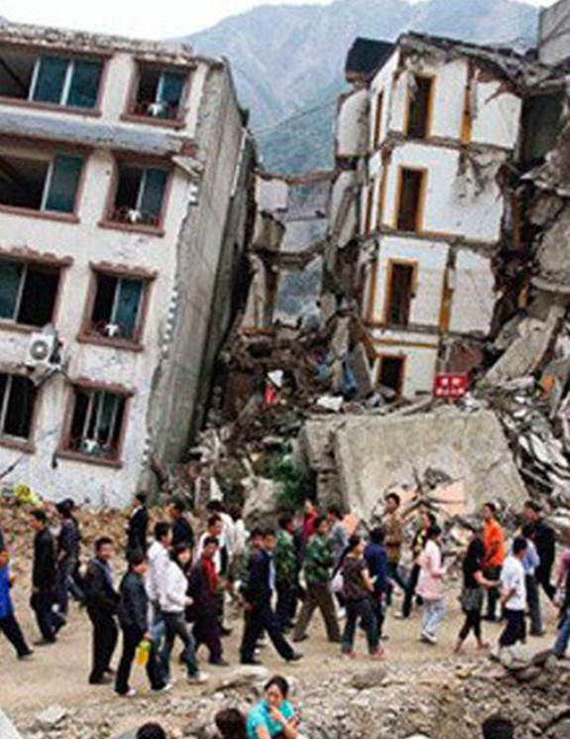
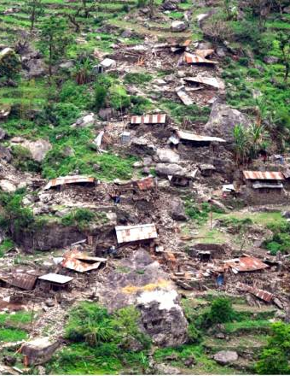
NEpal
Infrastructure failure
Social capital
Traditional knowledge
Everyday resilience
Build back better

Slide 6

West Africa
2014-16 Ebola
Lack of comms/ access to expertise
Delayed response
>11,000 lives
>22,000 orphans
>$2.2bn

Slide 7
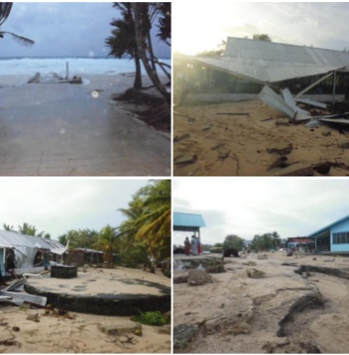
Tuvalu
Stretched supply chains
Infrastructure damage
Appropriate technology
Capacity building
“Hardening” solutions

Slide 8

Pondicherry
Swaminathan Village Knowledge Centres
ICT/networking
Peer-to-peer & external knowledge
Collateral benefits
>90 lives saved

Slide 9
Singapore workshop Findings
Build social capital
  Capacity building
  Information
  Accumulated assets
  Environmental stewardship & indigenous knowledge
Physical infrastructure
  Decentralised energy
  Innovative access to services
  Communication: early warning & recovery
  Health & lighting

Slide 10
Singapore workshop Findings…
Maintenance of infrastructure, not just construction
Resilience part of everyday discourse
Consider wider context
Unintended consequences
New risks inherent from new technologies
Integrated policymaking approach
Little “real-world” experience and evidence

Slide 11
POLICY suggestions FOR RESILIENCE
Providing centralised rural infrastructure & services is
  Expensive, slow & often low priority
Rural disaster recovery has similar challenges
Disasters, natural or manmade, are inevitable
Smart decentralised approach can be
  Lower cost, self-sustaining, technology-leapfrogging
  Also increases resilience

Slide 12
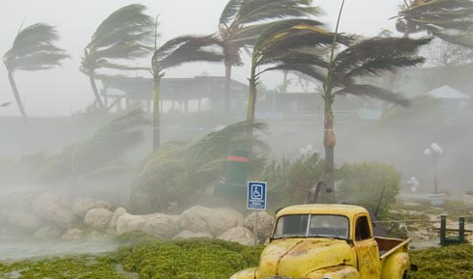


Slide 13

Thank you for your attention
www.e4sv.org | info@e4sv.org | @e4SmartVillages

